Slide 1

Frequency Support Mechanisms in Electricity Grid and Wind Turbine Applications
Erencan Duymaz
Friday, October 13th, 2017

Slide 2
About Me
Education
BSc. Electrical and Electronics Engineering METU
Power Systems and Power Electronics 2010-2016
MSc. Electrical and Electronics Engineering METU
Power Electronics and Electric Machines 2016-2018 (Expected)
Work Experience
Researcher at PowerLab Research Group
Aug 2016 - Present

Slide 3
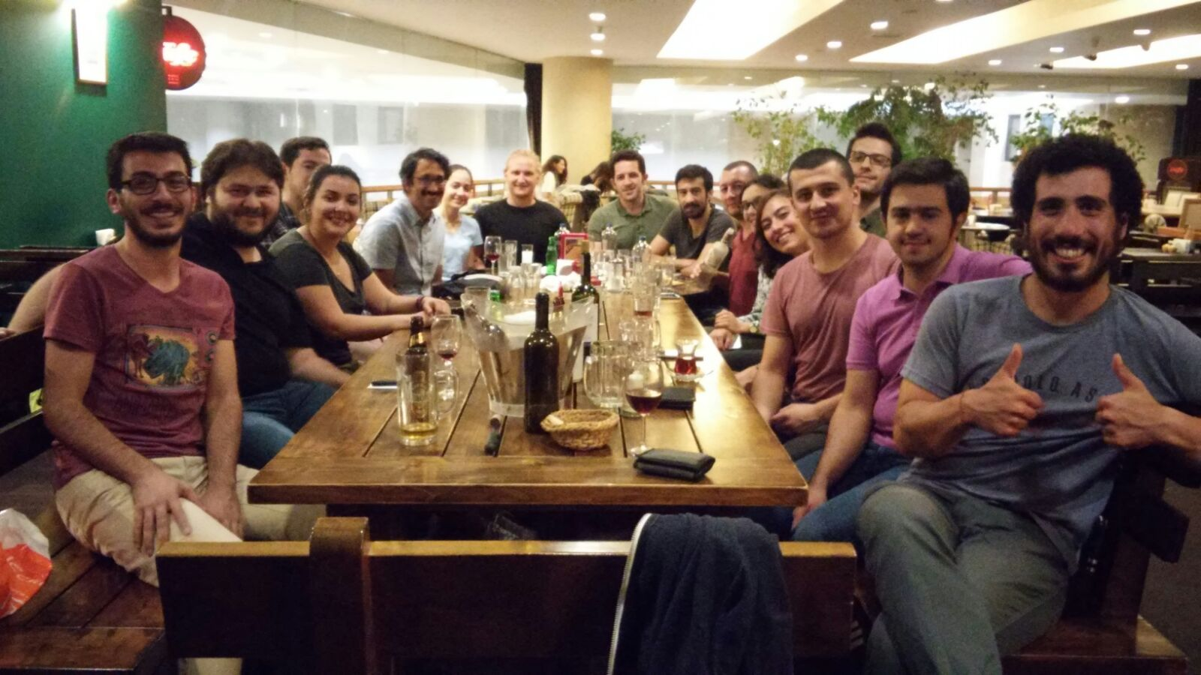
About PowerLab

Slide 4
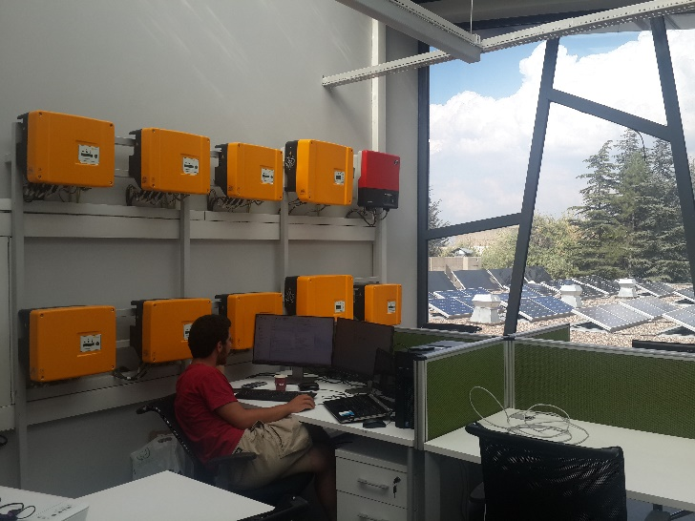
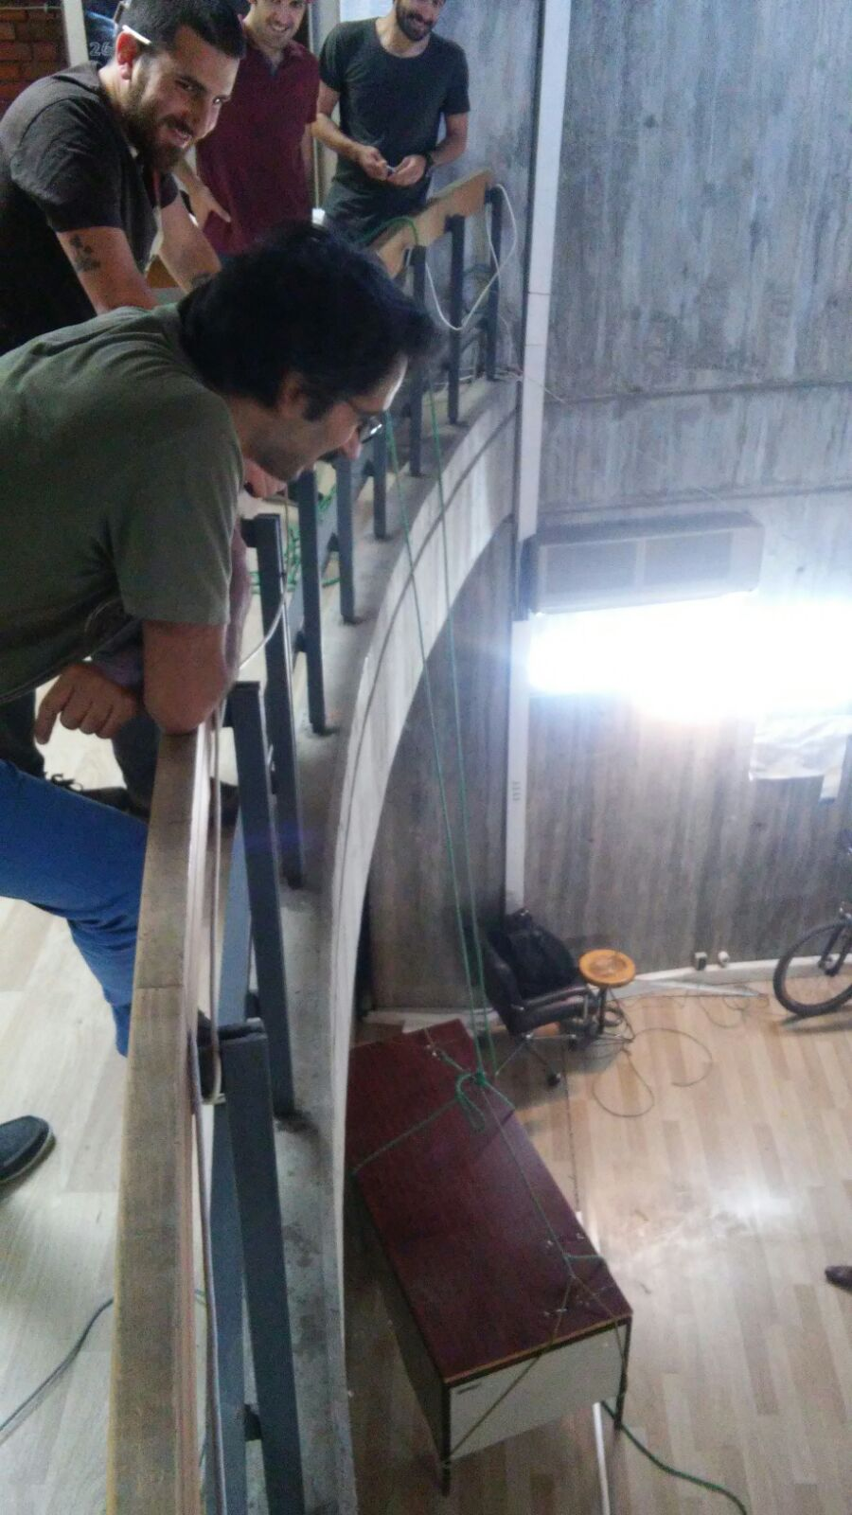
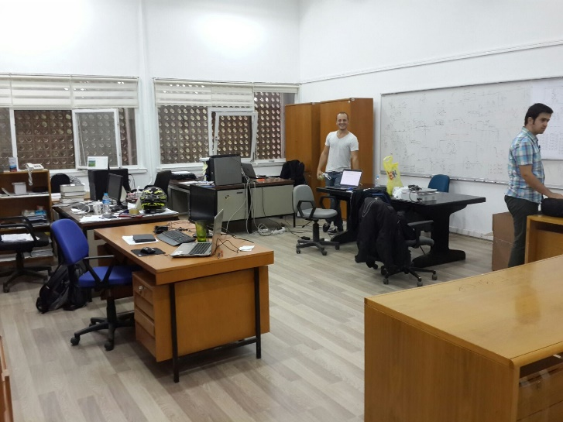
About PowerLab
ARC-300
C-114
E-101

Slide 5
Agenda
Renewable Energy Today
Renewable Energy Challenges
Frequency Dynamics
Synthetic Inertia and its implementation in Wind Turbines
Other Applications

Slide 6

Renewable Energy Today
EU target for 20% energy from renewable sources in gross final consumption for 2020. (2004)
National Action Plans which are ranging from 10% in Malta to 49% in Sweden. (2009)

Slide 7
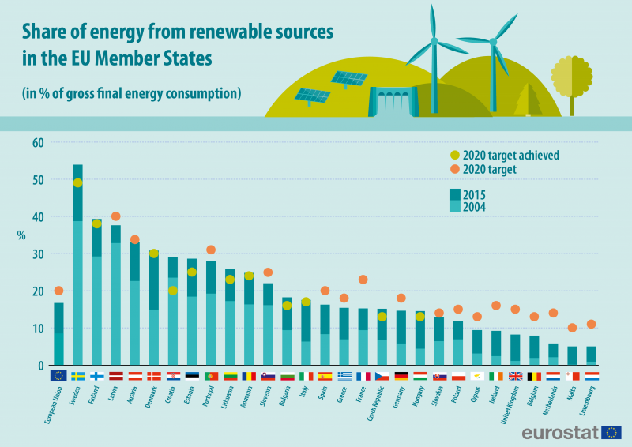
Renewable Energy Today
11 EU countries have already reached 2020 targets!!!

Slide 8
Renewable Energy Challenges
Uncertain Power Generation Profile
No Primary or Secondary controls
In the past;
Government buys whatever they generate
Free to disconnect
No ancillary services

Slide 9
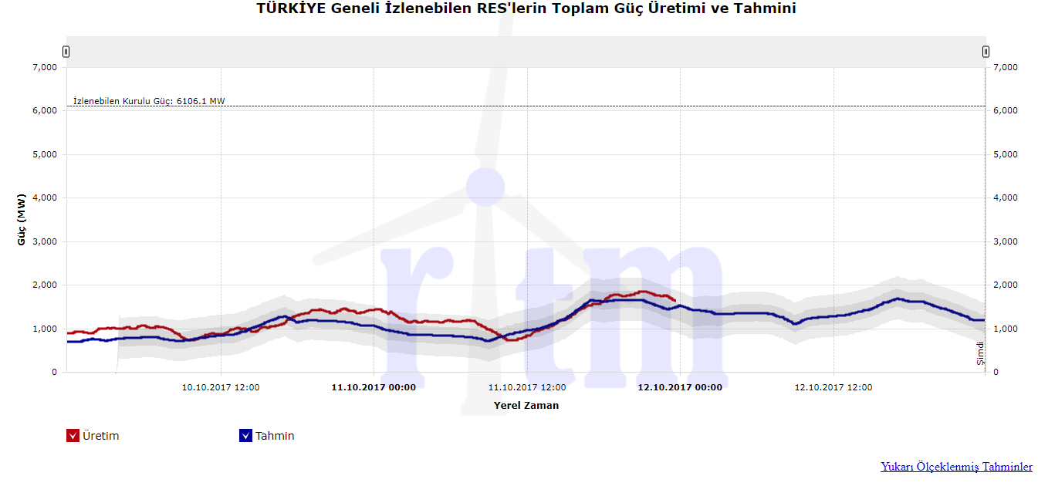
Production vs Forecast

Slide 10
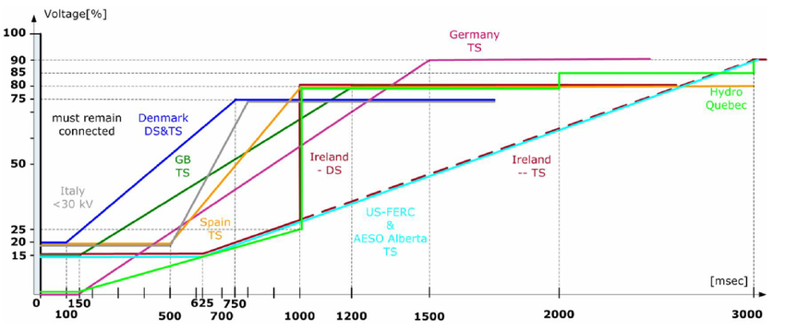
Renewable Energy Challenges-Voltage Regulation
LVRT requirements for different countries

Slide 11
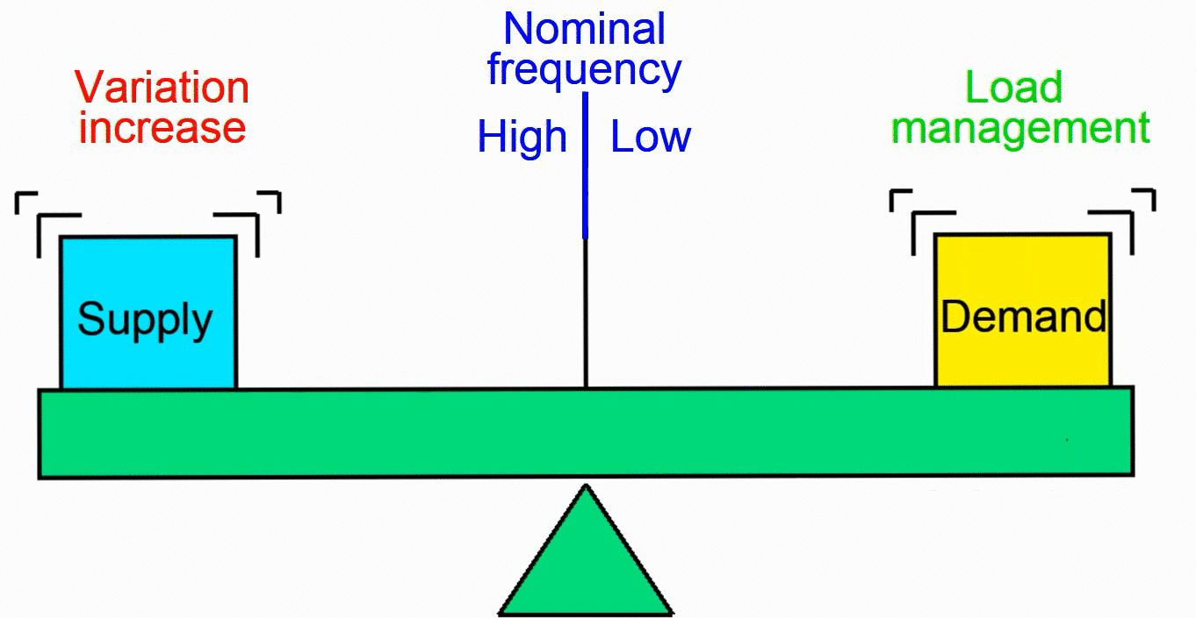
How frequency changes in grid?

Slide 12
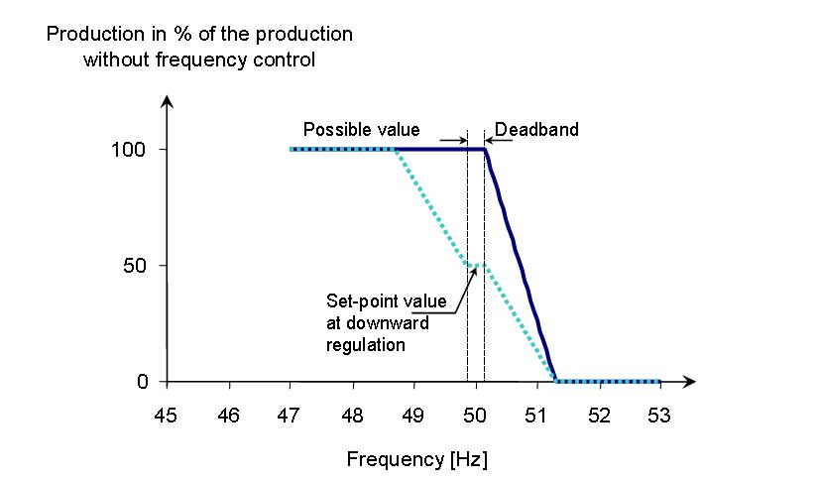
Renewable Energy Challenges-Frequency Stability
Active Power Curtailment for High Frequencies

Slide 13
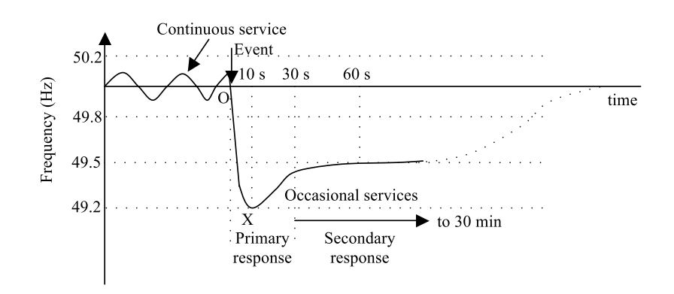
Frequency Regulating Mechanisms in Grid
Inertial Response, Primary and Secondary Responses

Slide 14
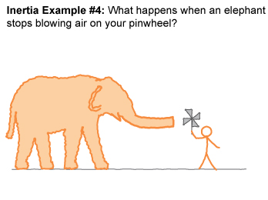
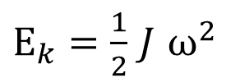
Inertia
Inertia = “resistance to change”
Proportional to rotating masses in the power system
Prevents the grid frequency from changing suddenly
The pinwheel keeps moving, even after the elephant stops blowing
$E_{k}=\frac{1}{2}$ $J$ $ω^{2}$
Notes:
A successful engineer must be able to communicate his findings and ideas to others.
Engineers are in need of communication more than most other professionals.
Clear presentations and reports brings an engineer to the attention of the project leader and management.
The purpose : transmission & reception of information
It is most important not to disregard the receiver of information.
Information must be in a form that can be understood by the receiver.

Slide 15
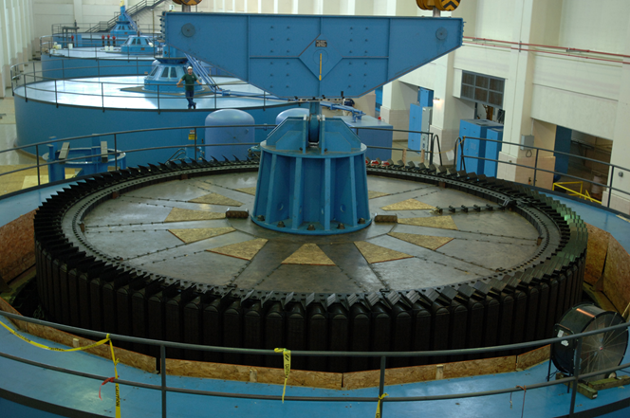
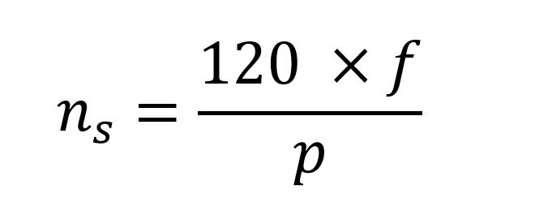
Frequency vs Synchronous Speed
Synchronous generators ‘inherently’ support the frequency with their inertia!

Slide 16
Frequency Regulating Mechanisms in Grid
Slope=RoCoF
Inertial Support following a frequency disturbance

Slide 17
Summary so far;
Primary and Secondary Controllers restore the frequency!
Primary Controllers acts within a few seconds!
Until the primary controller action, frequency decline is arrested by inertial response of the grid!
Larger grid inertia results in lower frequency dips and lower ROCOF (rate of change of frequency)

Slide 18
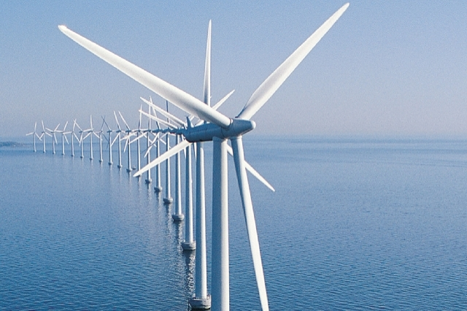

What is the problem with Renewable?
Aggravated grid inertia is decreasing with renewable penetration!

Slide 19
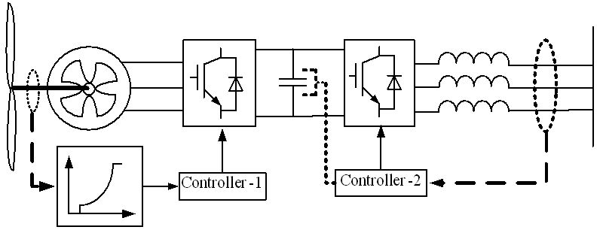
Renewable Sources

Slide 20
Solution : Synthetic Inertia
Frequency is monitored!
Decrease speed
Inject more power to arrest the frequency decrease!

Slide 21
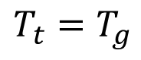
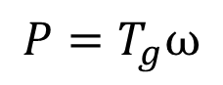
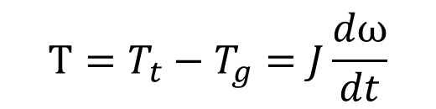
Solution : Synthetic Inertia
$$T_{t}=T_{g}$$
$$T=T_{t}−T_{g}=J\frac{dω}{dt}$$
$$P=T_{g}ω$$
It is possible to increase active power but how much?

Slide 22
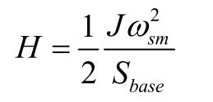
Definition: Inertia Constant (s)
Simply, how many seconds you can supply power by using your kinetic energy!
Generator inertia constants vary between 2-9 seconds.
One can imitate a synchronous generator behaviour with desired inertia constant!

Slide 23
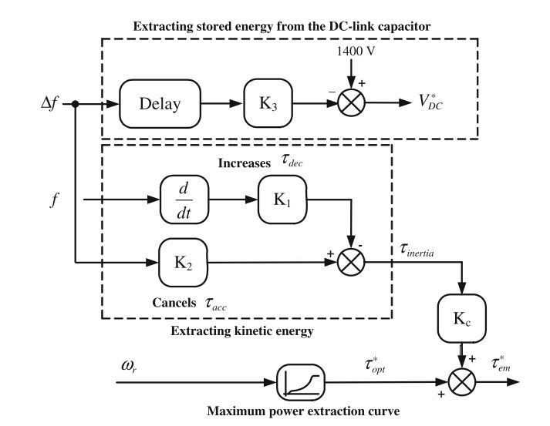
Solution : Synthetic Inertia
Control Diagram of the Frequency Based Inertial Control

Slide 24


Synthetic inertia:
You can imitate the synchronous generator behaviour in the renewables.
All you need is spare energy!
$$P_{add}=\frac{ΔE}{Δt}$$

Slide 25
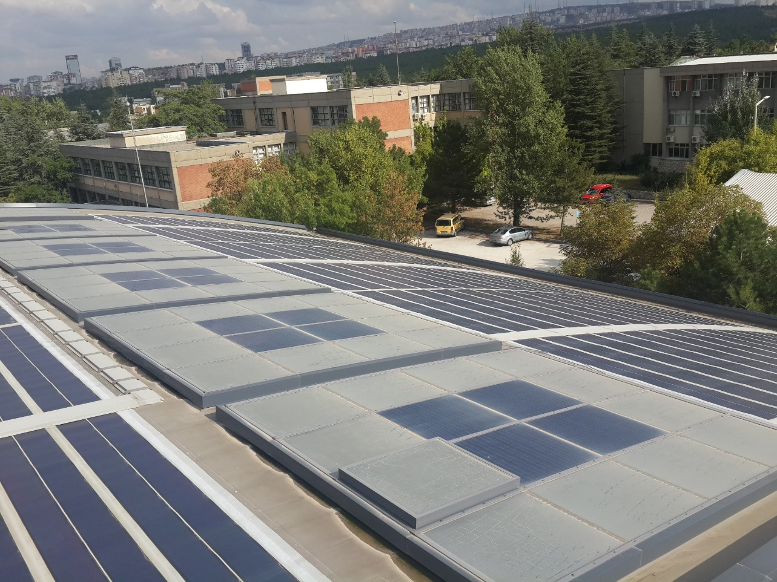
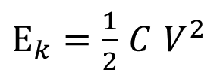
Other Applications-Photovoltaic Systems
$E_{k}=\frac{1}{2}$ $C$ $V^{2}$

Slide 26
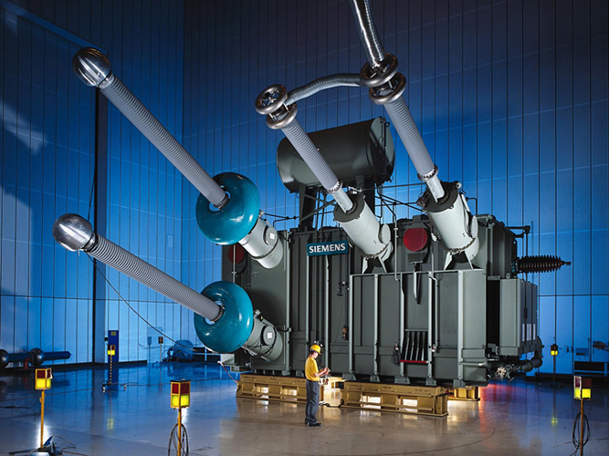

Other Applications-HVDC Transformers
Between Countries such as Turkey-Georgia
Between Offshore WTs and the substations in the land

Slide 27
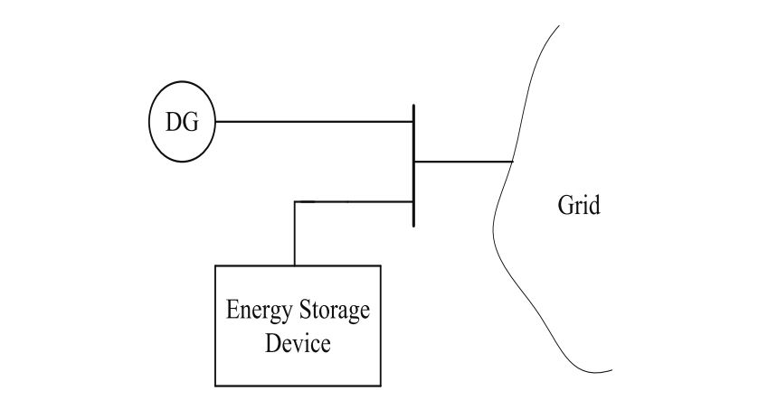
Other Applications-Energy Storage Devices
Battery
Flywheel

Slide 28
Conclusion
Renewable Energy and its challenges
Frequency Regulating Mechanisms
Inertial Support
Primary Controllers
Secondary Controllers
Synthetic Inertia in Wind Turbines
Other Applications

Slide 29
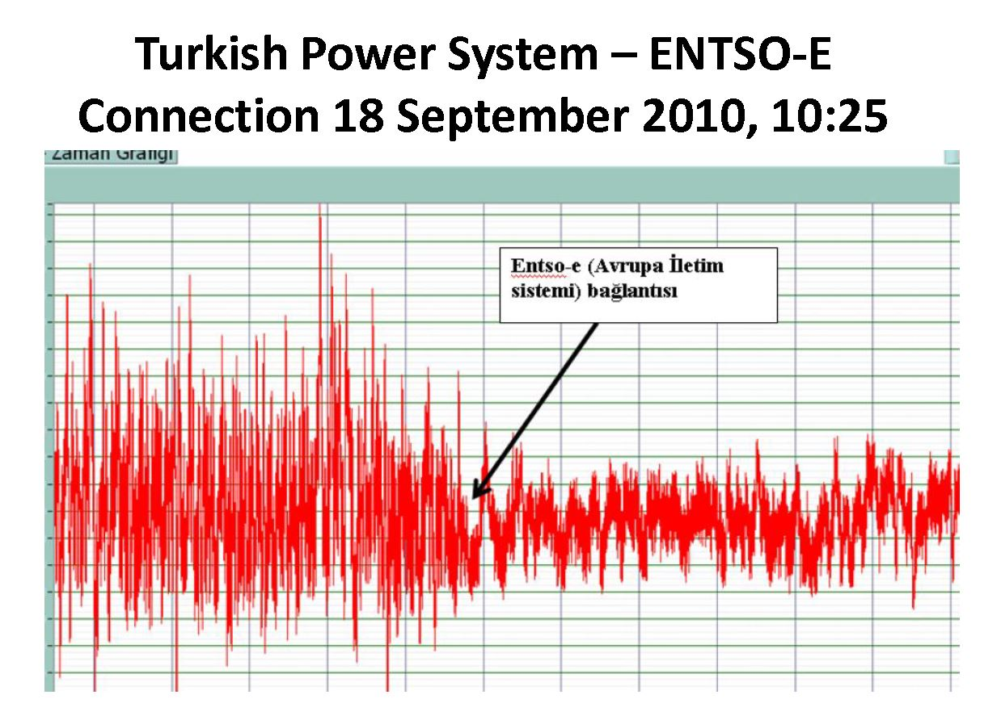
Connection of Turkish Power System to Europe

Slide 30
References
A. Ulbig, T. S. Borsche, and G. Andersson, “Analyzing Rotational Inertia, Grid Topology and their Role for Power System Stability,” IFAC-PapersOnLine, vol. 48, no. 30, pp. 541–547, 2015.
N. Güven, “INTRODUCTION TO POWER SYSTEMS ” EE 472 POWER SYSTEM ANALYSIS II
Eltra and Elkraft, “Wind turbines connected to grids with voltages below 100 kV,” 2004.
E. Muljadi, V. Gevorgian, and M. Singh, “Understanding Inertial and Frequency Response of Wind Power Plants Preprint,” 2012 IEEE Power Electron. Mach. Wind Appl., no. July, pp. 1–8, 2012.
F. M. Gonzalez-longatt, “Activation Schemes of Synthetic Inertia Controller on Full Converter Wind Turbine ( Type 4 ),” no. Type 4, 2015.
Check PowerLab Mendeley folder for more related documents!

